Slide 1
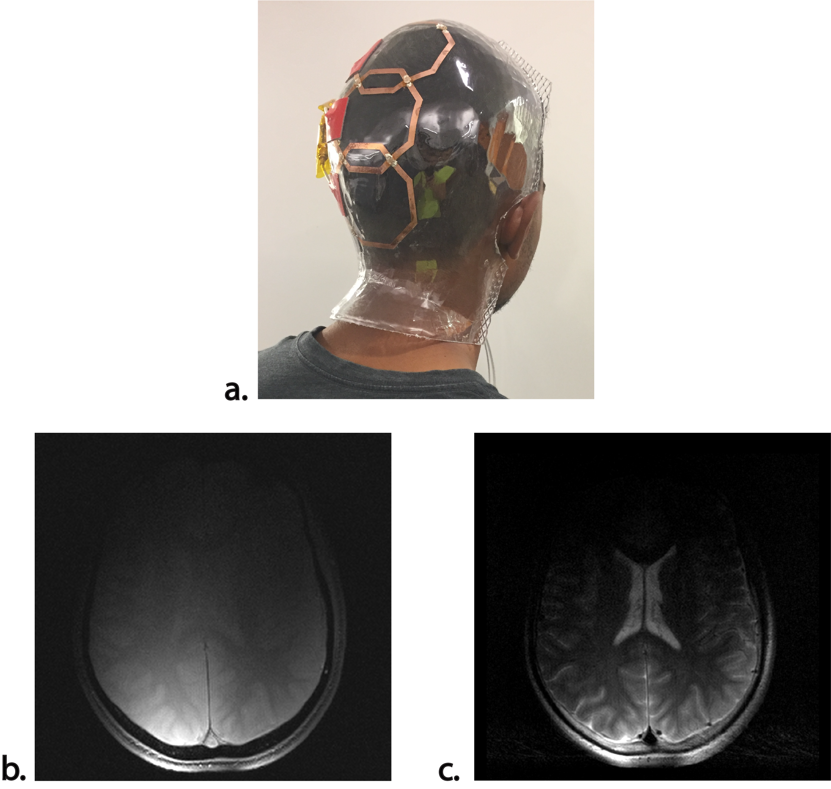
Intro/Motivation
Vacuum forming, combined with printed electronics can be used to create custom MRI coils that produce higher SNR scans compared to conventional hardware
The process involves heating a plastic sheet, pulling it over a mold, and drawing a vacuum so that the sheet conforms to the desired geometry

Slide 2
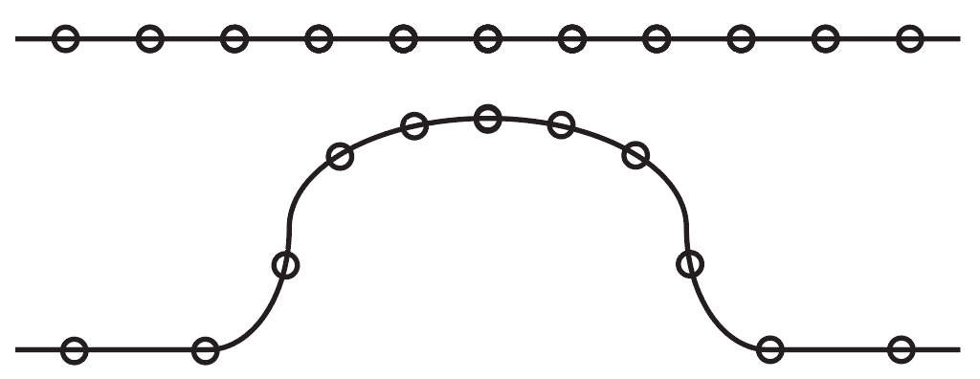
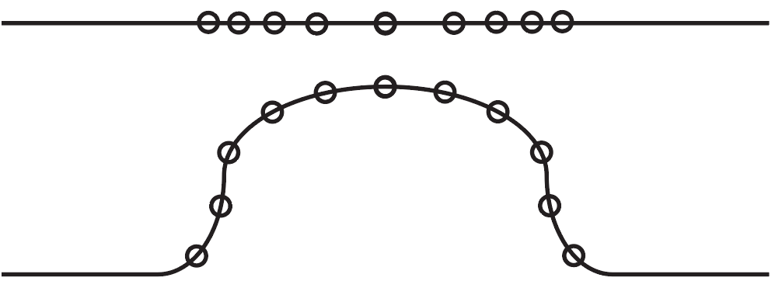
Problem
Uniformly Patterned
The vacuum forming process introduces a large change in surface area
This causes any pattern to distort
We plan to build a physical simulation along with a pre-distortion algorithm based on conformal mapping
Pre-distorted

Slide 3
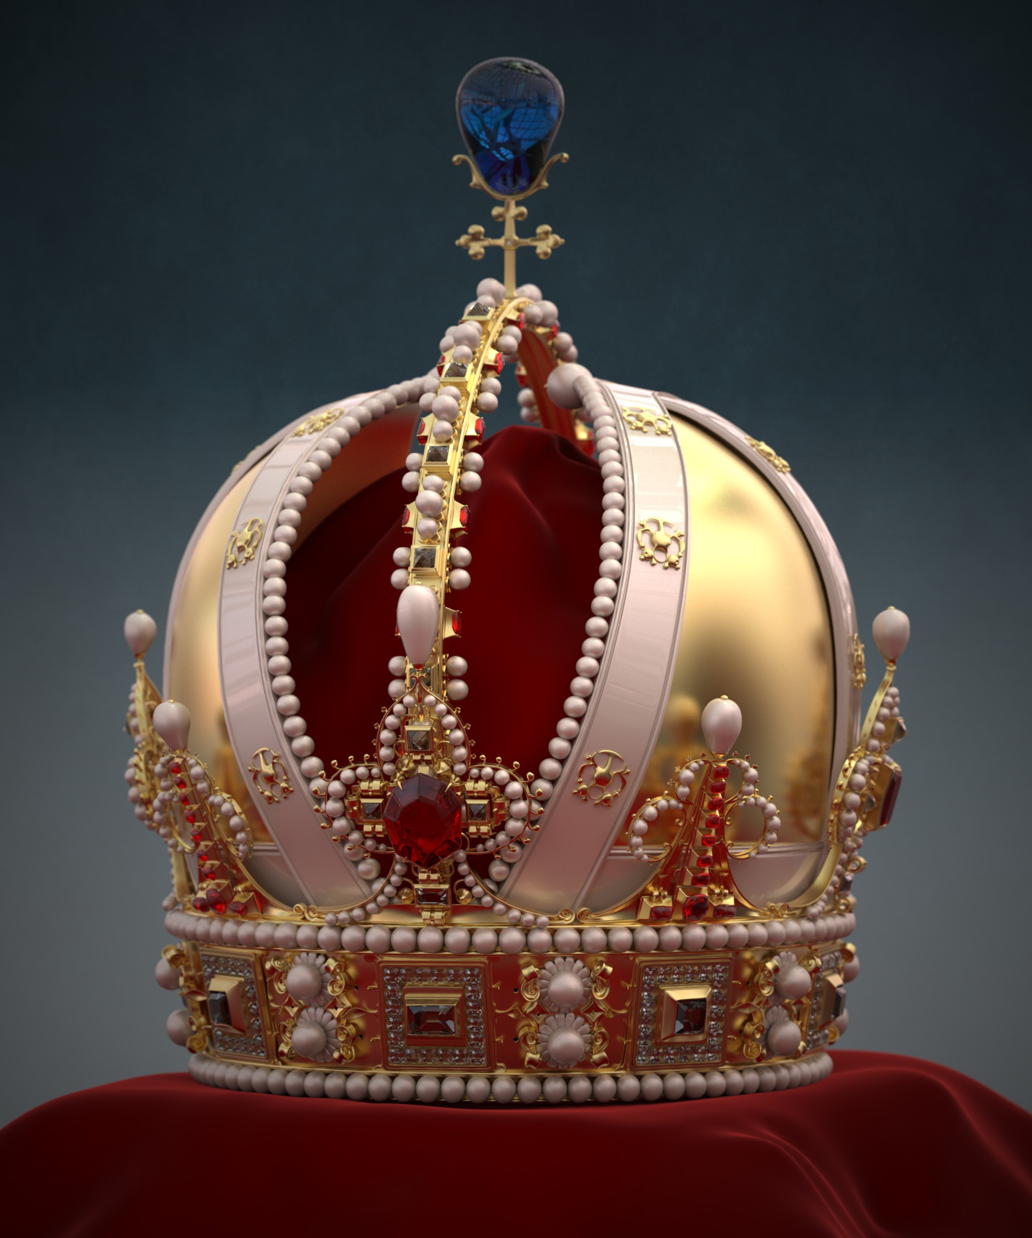
Progress/Future Work
We have adapted project 4 into a vacuum forming simulation. By integrating Intel’s ray tracing engine (Embree), we implemented a simple collision detection algorithm for arbitrary meshes
Pre-distortion will be accomplished by implementing a conformal mapping algorithm which is commonly used to texture meshes
More realistic physical models and integration methods will be included as well

